Slide 1
LX Introduction to Machine Learning
Z. Gu 2021

Slide 2
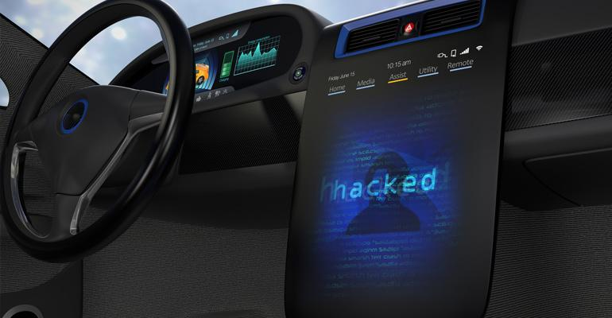
SECURITY

Slide 3
Traditional Automotive Cyber-Security
Integrity and authenticity of in-vehicle SW
e.g., OTA (Over-The-Air) updates that compromise in-vehicle SW
Integrity, authenticity and confidentiality of in-vehicle and V2X communication
e.g., message spoofing to disrupt a vehicle platoon
Proof of platform integrity and authenticity to remote entities
e.g., with Public Key Infrastructure (PKI)
Integrity of HW Security Module
Access control to in-vehicle data
Notes:
From 05-Internet of Cars Part 3 - Software Management on Vimeo
e.g., Prevention/detection of tampering with Certification Authorities

Slide 4
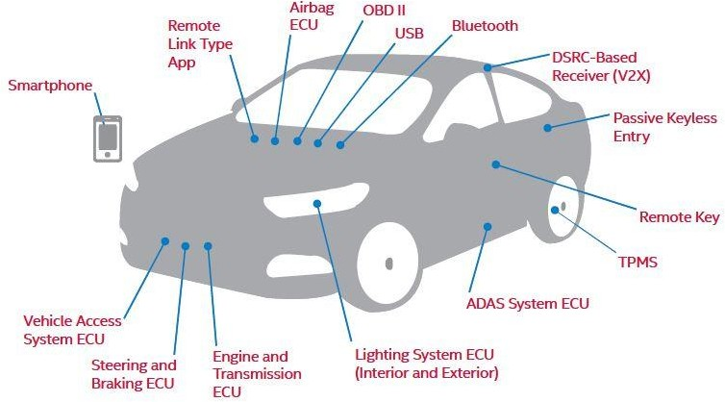
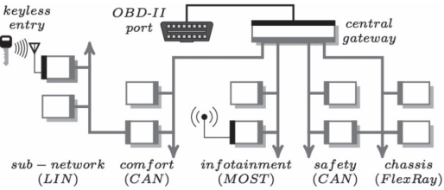
Vehicle Attack Surface
Electrical Control Units (ECUs)
Airbag, Advanced Driver Assistant System, Engine, Steering & Brakes, etc.
On-Board Diagnostics (OBD) II Diagnostic Port
USB Ports
Passive Keyless Entry / Remote Key
Remote Link Type App
Tire Pressure Monitoring System (TPMS)
V2X Receiver (DSRC or C-V2X)
https://www.mcca.com/wp-content/uploads/2018/04/Autonomous-Vehicles.pdf
Notes:
Electrical Control Units (ECUs)
Airbag, Advanced Driver Assistant System, Engine, Steering & Brakes, etc.
On-Board Diagnostics (OBD) II Diagnostic Port
Dedicated Short-Range
Communications-Based Receiver
USB Ports
Passive Keyless Entry/ Remote Key
Remote Link Type App
Electronic Control Units (ECUs) – ECUs are embedded systems that control one or more electrical systems or subsystems within a vehicle and are connected via an internal network. They control systems like the engine and transmission, steering and brakes, infotainment, lighting, etc. Risks arise when access to ECUs (usually peripheral ECUs like an infotainment system) are breached and malicious actors are able to access certain ECUs or the whole network. Vehicles today have up to 100 ECUs onboard.
OBD II Diagnostic Port – Every car manufactured after 1996 and sold in the U.S. must have an OBD II installed. The port was originally mandated to permit monitoring of emissions, etc. It is increasingly used to facilitate non-diagnostic features like enabling Wi- Fi, or enabling an insurance company to track usage through attachment of a “dongle” to the port. These ports can provide a means of access for attackers into an otherwise secure system.
DSRC-Based Receivers – DSRC is being promoted as a means of encouraging V2V and vehicle-to-infrastructure (V2I) communications. The short-wave communications can be subject to spoofing and other attacks. There’s now a push to move to more advanced 5G- based communications.

Slide 5
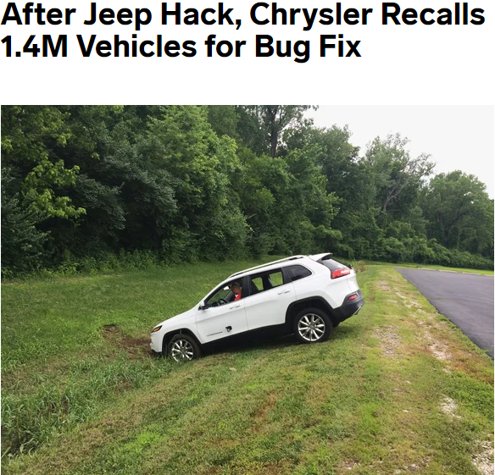
The 2015 Jeep Hack
In 2015, security researchers Charlie Miller and Chris Valasek wirelessly hacked a Jeep, taking over dashboard functions, steering, transmission and brakes. They gained access through Uconnect, an Internet-connected computer feature that controls the vehicle's entertainment and navigation, enables phone calls, and even offers a Wi-Fi hot spot. From that entry point, they rewrote ECU firmware to send commands through the CAN bus to control steering and acceleration.
To fix the bug, Chrysler owners were sent a USB drive with a software update they can install through the port on their vehicle's dashboard.
https://www.wired.com/2015/07/hackers-remotely-kill-jeep-highway/

Slide 6
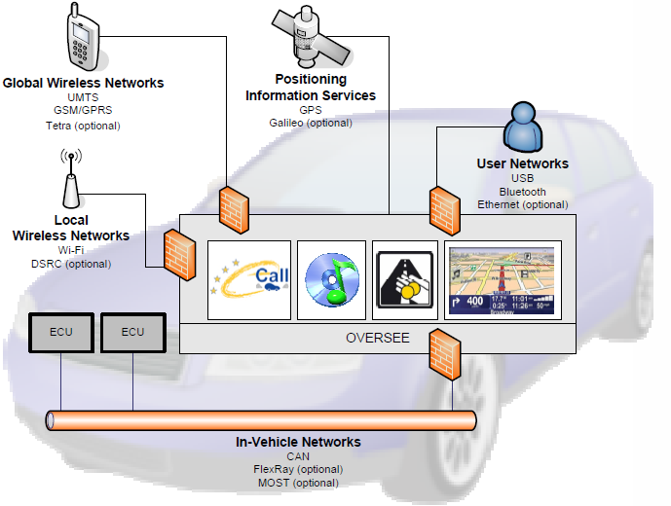
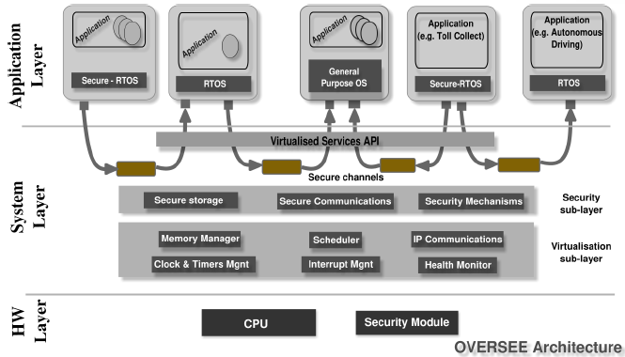
OVERSEE (Open VEhiculaR SEcurE platform)
As an example approach to automotive cyber-security, consider OVERSEE, an EU project completed in 2012.
A generic and open source platform for spatial and temporal partitioning of secure simultaneous execution of multiple innovative automotive applications on one single OVERSEE ECU
An open and standardized secure single point of access to in-vehicle networks
The concept is similar to a firewall that protects the intranet from outside attacks. (I think this platform could have prevented the Jeep hack in 2015.)
But what if the attackers somehow managed to get into the vehicle internal network? Then we need intrusion detection.
Notes:
a standardized interface for accessing security services A secure and dependable runtime environment
A secure software platform based on virtualization that serves as single Point of Access to vehicle networks

Slide 7
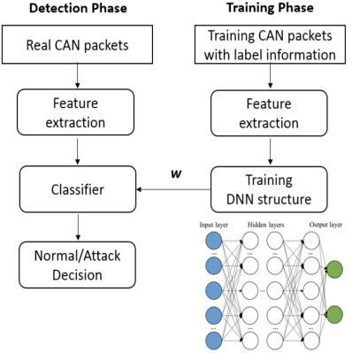
ML-based Intrusion Detection
Many approaches exist. I mention just one work here.
At training phase, a DNN-based classifier is trained with supervised learning, with CAN packets labeled as real packet or attack packet.
At detection phase, the classifier is used to classify packets and identify malicious attacks.
https://www.researchgate.net/publication/328107877_Cybersecurity_in_Autonomous_Vehicles
Notes:
he system will train every CAN packets and mark them with binary label information and extract features, then utilize DNN structure to train the features with weight parameters. In the detection phase, the same CAN features will be extracted, and the DNN structure computes with the trained parameters will help make the final decision.
After introducing DNN structure which can provide the probability of intrusion, the IDS can help discriminate secure and insecure packets and finally identify malicious attacks.
A firewall like OVERSEE can prevent attackers from gaining access to vehicle interval network
My opinion: A straightforward application of anomaly detection for automotive security.

Slide 8
Data Privacy Vulnerabilities
Data related to vehicle journeys
Car makers, app developers, on-board assistance systems, etc. collect data regarding movements of vehicle. Length of time data is kept, who has access to it, and whether consumer has right to opt-out are key issues.
Data on consumer habits and preferences
Data ranging from music preferences, news and radio selections, and other features is being used to target consumers. How this is done and whether consent is obtained will dictate potential ramifications.
Data from or related to children
Collection, use, and storage of children’s data is governed by special rules which should be considered.
Differences in regulations between markets
Privacy regulations vary widely by region and market. For example, the EU’s GDPR includes a broad definition of personal information and strict requirements for consent and use and protection of such data.
Notes:
Points to note:
Build privacy protections into system designs.
Obtain consent when collecting data.
Recognize that children pose special risks.
Limit collection of sensitive information.
Plan for and be ready to notify consumers in the event of an incident.

Slide 9

Automotive Cyber-Physical Security
Cyber-Physical attacks, e.g., non-invasive attacks on sensors/actuators in the Physical domain cannot be thwarted by traditional security mechanisms in the Cyber domain
Camera spoofing with adversarial images; injection of false video frames, incl. record-and-replay
GPS spoofing with fake GPS signals
Lidar spoofing with record-and-replay
Attackers do not even need to hack into the E/E system (like the 2015 Jeep hack), so a firewall approach like OVERSEE would not help here.
Attacks on sensors and actuators
+
Plant
+
Controller

Slide 10

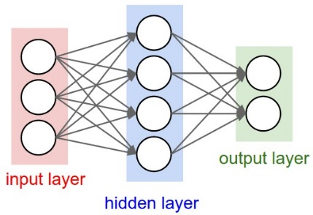

DNN’s Lack of Robustness
DNNs are known to be unpredictable and unreliable.
Simpler ML algorithms, e.g., decision trees, can be fully-verified
Adversarial example: an input that is a slight perturbation of another input causes the classifier to give wrong output.
e.g., A “STOP” sign with some stickers on it is misclassified as a “Speed Limit” sign.
It’s a DOG!
Notes:
Practical Black-Box Attacks against Machine Learning
Nicolas Papernot 2017
Maximum Resilience of Artificial Neural Networks Chih-Hong Cheng, Georg N¨uhrenberg, and Harald Ruess Recent work on formal verification of DNN models with SMT or MILP [Cheng et al 2017][Katz et al 2017]… Achieved by poisoning the training set, or evasion after training
[Papernot et al 2017]

Slide 11
MobilBye: Attacking ADAS with Camera Spoofing
From Ben Gurion University, 2019.
“We injected spoofed traffic signs into Mobileye to assess the influence of environmental changes (e.g., changes in color, shape, projection speed, diameter and ambient light) on the outcome of an attack.”
“We used a drone to carry a portable projector which projected the spoofed traffic sign on a driving car. Our experiments show that it is possible to fool Mobileye so that it interprets the drone carried spoofed traffic sign as a real traffic sign.”
MobilBye
https://www.youtube.com/watch?v=C-JxNHKqgtk&feature=youtu.be
https://www.nassiben.com/mobilbye

Slide 12
Phantom of the ADAS
From Ben Gurion University, 2020.
A phantom is a depthless object intended at causing ADASs and autopilot systems to perceive the object and consider it real. The object can be an obstacle (e.g., person, car, truck, motorcycle), lane, or road sign.
They apply phantom attacks by projecting a phantom via a drone equipped with a portable projector or by presenting a phantom on a hacked digital billboard that faces the Internet and is located near roads.
Phantom of the ADAS: Phantom Attacks on Driving Assistance Systems
https://www.youtube.com/watch?time_continue=85&v=1cSw4fXYqWI&feature=emb_logo
https://www.nassiben.com/phantoms
Notes:
“we investigate a new perceptual challenge that causes the ADASs and autopilots of semi/fully autonomous to consider depthless objects (phantoms) as real. We show how attackers can exploit this perceptual challenge to apply phantom attacks and change the abovementioned balance, without the need to physically approach the attack scene, by projecting a phantom via a drone equipped with a portable projector or by presenting a phantom on a hacked digital billboard that faces the Internet and is located near roads. We show that the car industry has not considered this type of attack by demonstrating the attack on today’s most advanced ADAS and autopilot technologies: Mobileye 630 PRO and the Tesla Model X, HW 2.5; our experiments show that when presented with various phantoms, a car’s ADAS or autopilot considers the phantoms as real objects, causing these systems to trigger the brakes, steer into the lane of oncoming traffic, and issue notifications about fake road signs. In order to mitigate this attack, we present a model that analyzes a detected object’s context, surface, and reflected light, which is capable of detecting phantoms with 0.99 AUC. ”

Slide 13
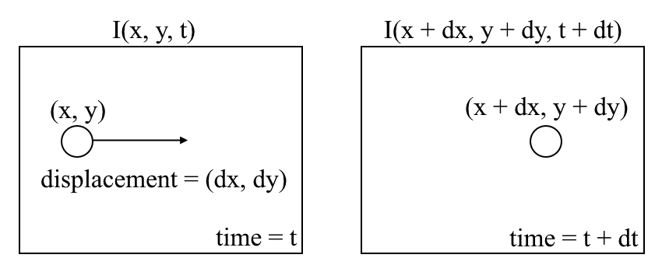
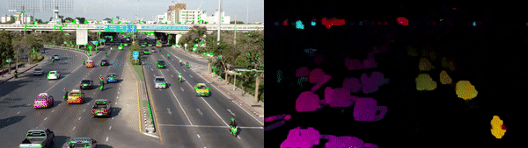
Quick Intro to Optical Flow
Optical flow is the motion of objects between consecutive frames of sequence, caused by the relative movement between the object and camera.
Classic algorithm: Lucas-Kanade
Modern algorithm: DNN-based
Left: Sparse Optical Flow - track a few "feature" pixels;
Right: Dense Optical Flow - estimate the flow of all pixels in the image.
Notes:
https://nanonets.com/blog/optical-flow/

Slide 14
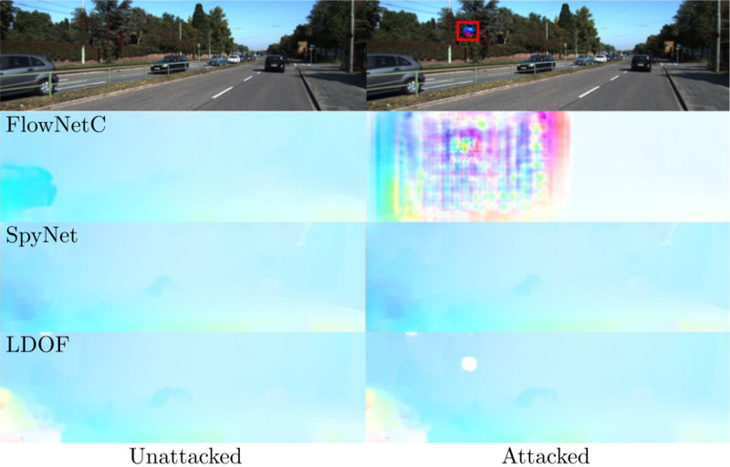
Attack on Optical Flow
From Univ. Tübingen, 2019.
Researchers showed that optical flow systems based DNN are vulnerable to adversarial attacks.
The first column shows the optical flow results using an encoder-decoder architecture FlowNetC, a spatial pyramid architecture SpyNet and classical method LDOF.
In the second column, a small circular patch is added to both frames at the same location and orientation (highlighted by the red box for illustration purpose).
SpyNet and LDOF are barely affected by the patch. In contrast, FlowNetC is strongly affected, even in regions far away from the patch.
Color patch could throw self-driving vehicles off track
https://www.youtube.com/watch?v=FV-oH1aIdAI
https://is.mpg.de/news/color-patch-could-throw-self-driving-vehicles-off-track

Slide 15
Adversarial Sensor Attack on LiDAR-based AV Perception
LiDAR spoofing attack works by shooting lasers to inject spoofed LiDAR data points.
Attack goal: add spoofed obstacles in close distances to the front of a victim AV (or front-near obstacles) in order to alter its driving decisions.
Attack scenarios:
(1) emergency brake attack, which may force a moving AV to suddenly brake and thus injure the passengers or cause rear-end collisions.
(2) AV freezing attack, which may cause an AV waiting for the red light to be permanently “frozen” in the intersection and block traffic.
Adv LiDAR Attack Simulation Demo
https://www.youtube.com/watch?time_continue=13&v=hYuvmwzqmsY&feature=emb_logo
https://sites.google.com/view/cav-sec/adv-lidar-attack
Notes:
From UC Irvine, 2019.

Slide 16
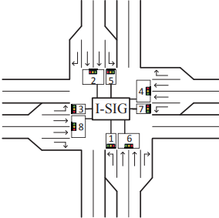
Congestion Attack on CV-based Traffic Signal Control
From Univ. Michigan, 2018.
I-SIG (Intelligent Traffic Signal System):
Real-time vehicle trajectory data transmitted using the Connected Vehicles (CV) technology are used to intelligently control the duration and sequence of traffic signals.
Congestion Attack
The attacker can compromise her own vehicle or other people’s vehicles (physically, wirelessly, or through malware), and send malicious CV messages with spoofed driving data (e.g., speed and location) to the I-SIG system
One single attack vehicle can greatly manipulate the intelligent traffic control algorithm in the current I-SIG system and cause severe traffic jams.
Attack on V2X communication (not a physical sensor, but acts like a sensor).
Demo: Congestion Attack on Connected Vehicle based Traffic Signal Control
https://www.youtube.com/watch?v=3iV1sAxPuL0&feature=emb_logo
https://sites.google.com/view/cav-sec/congestion-attack
Notes:
Congestion creation vulnerabilities. Our security analysis finds that the current signal control algorithm design and implementation choices in I-SIG have congestion creation vulnerabilities, which can be exploited to greatly manipulate traffic signal planning decisions and create traffic congestion via CV data spoofing from even one single attack vehicle. We construct concrete exploits for these vulnerabilities and evaluate them using simulation under real-world intersection settings. The results show that these vulnerabilities can be exploited to cause massive congestion and can even cause a blocking effect to jam an entire intersection direction (see video demo below). In the jamming period, the travel time is > 6× higher for half of the passing vehicles, and > 14× higher for 22% of them.

Slide 17
Mitigation Techniques for Sensor Attacks
Heterogeneous sensors to exploit different failure modes (camera, Lidar, Radar, GPS, IMU…)
Secure state estimation in the presence of attacks w/ sensor fusion
Many others
Notes:
ML algorithms for intrusion detection (Deep Learning, Bayesian Networks…)

